Slide 1

Bottom Copper

Slide 2

Internal 4 Cu

Slide 3

Internal 3 Cu

Slide 4

Internal 2 Cu

Slide 5

Internal 1 Cu

Slide 6

Front Copper

Slide 7
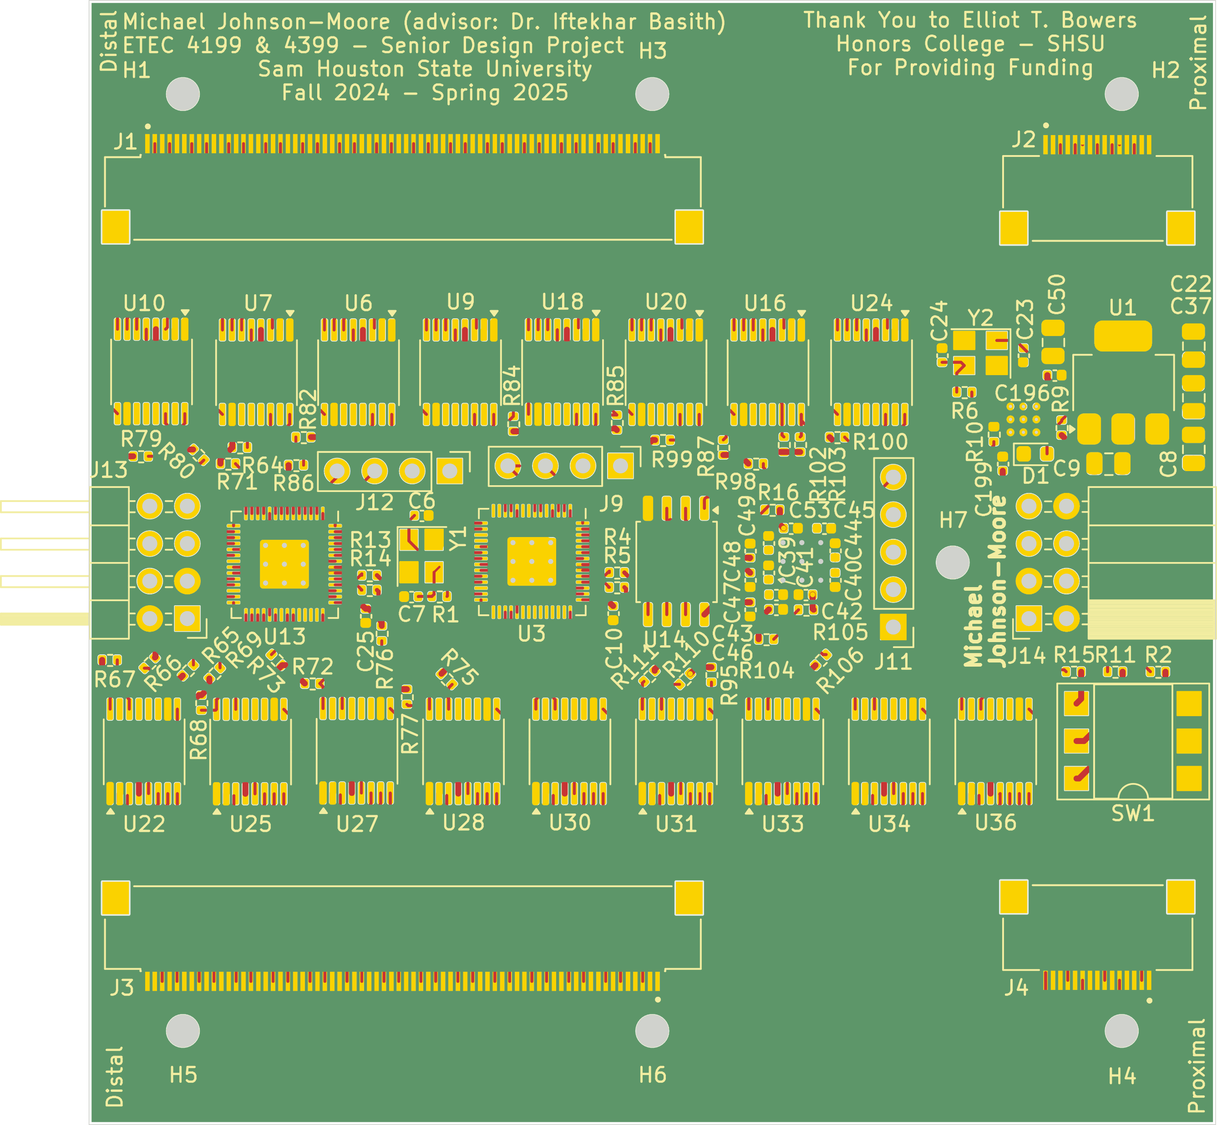
Gold Plating
Soldermask
Front Text

